Slide 1
Team Project
Fernandes Lowe, Minami Imoto

Slide 2
1. Motivation & Summary
Description: Mortgage Payment Trends
Question:
How much is the average mortgage price in Loop?
How much does mortgage price change between summer and winter?
Does mortgage price have trends by Zipcode?
How number of rooms, foot, or build year in a mortgage correlates with the amount?
Dataset used:
Zillow API
Notes:
Define the core message or hypothesis of your project.
Describe the questions you asked, and why you asked them
Describe whether you were able to answer these questions to your satisfaction, and briefly summarize your findings
What’s kind of data you needed to answer them and where you found it
Original questions ----
Mortgage increase between summer and winter in Loop (Chicago)
How much rent price goes up in summer compared to winter
Mortgage trends over years
Gender / Age of people movement – where / when / how
Which areas in Loop are changed the mortgage payment the most
Is there any correlation between moving population vs mortgage increase
Increase% of mortgage payment against build year and home size

Slide 3
2. Data Cleanup & Exploration
Scope: Chicago Loop (60601 through 60606)
The number of raw data imported: 21K
Dropped blank Zillow ID
Home Type: Condominium: 17K
Bedrooms / Bathrooms: 3K used for Scatter Plot
Problems to import data
Zillow API only provides owner review rates for free -> Used a package other people published with Zillow API
Even not provided addresses -> Copied the list of addresses from Trulia. Did not include 60607 and 60616 due to constraints
Notes:
Describe the exploration and cleanup process
Discuss insights you had while exploring the data that you didn't anticipate
Discuss any problems that arose after exploring the data, and how you resolved them
Present and discuss interesting figures developed during exploration, ideally with the help of Jupyter Notebook
But Trulia addresses do not always match with Zillow’s thus unmatched addresses are dropped in the cleaning process.

Slide 4
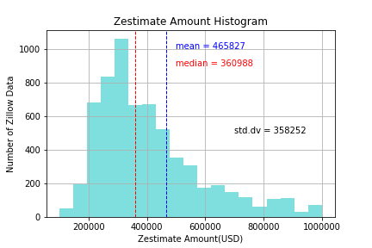
3. Data Analysis
The average of mortgage amount (Zestimate amount) in loop is 360KUSD as average and 465KUSD as median.
Notes:
Did you find what you expected to find? If not, why not? What inferences or general conclusions can you draw from your analysis?
Zestimate amount in loop is 360K as average and 465K as median
Std dev check

Slide 5
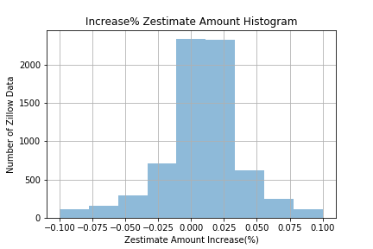
3. Data Analysis
Zestimate amount (mortgage amount) changes between -0.01% and 0.025% for 30 days.
Notes:
Did you find what you expected to find? If not, why not? What inferences or general conclusions can you draw from your analysis?

Slide 6
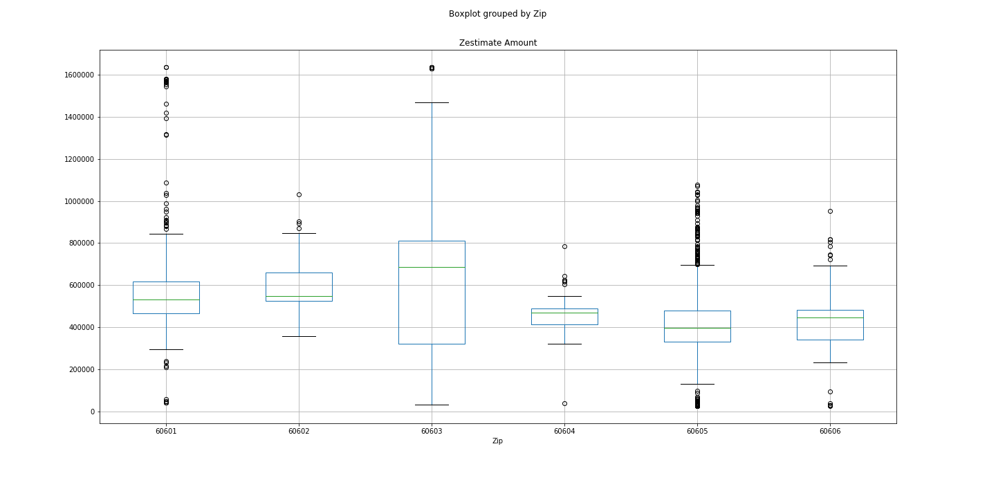
3. Data Analysis
South loop (60605) is the most reasonable option in Loop as they have lowest median, lowest first quartile compared to other zip and the data range is between 200K – 700K.
Notes:
Did you find what you expected to find? If not, why not? What inferences or general conclusions can you draw from your analysis?
South loop is the most reasonable option in Loop with lowest median, lowest first quartile
60603 -? Is the most expensive area in Loop.
400K – 700K

Slide 7
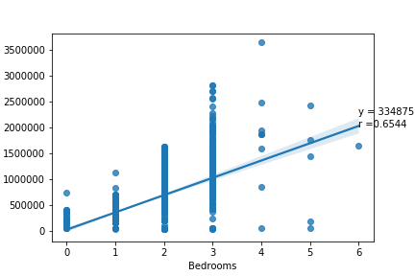
3. Data Analysis
60601 only now – to be attached all Zip? To be considered..
This is the correlation between number of bed rooms and zestimate amount.
They have moderate correlation since r = 0.6 *r > 0.7 is strong correlation between them.
Reason not having strong regression
Number of rooms, not foot
Notes:
Did you find what you expected to find? If not, why not? What inferences or general conclusions can you draw from your analysis?
Why 3 bed rooms have some no value here? Should be excluded 0 value.

Slide 8
3. Data Analysis
Hypothesis Testing –
Hypothesis: in Loop, the zestimate amount does have same variance by zip
Null Hypothesis: In Loop, the zestimate amount does not have same variance by zip
Use: Box Plot – p > 0.05 = does have variance by zip
Notes:
Did you find what you expected to find? If not, why not? What inferences or general conclusions can you draw from your analysis?

Slide 9
4. Findings
Original Question:
How much is the average mortgage price in Loop? ▷ Add number later
How much does mortgage price change between summer and winter? ▷ Not able to find
Does mortgage price have trends by Zipcode? ▷ To some extent but not as expected
How number of rooms, foot, or build year in a mortgage correlates with the amount? ▷ number of rooms has Moderate effect against mortgage amount
Notes:
Did you find what you expected to find? If not, why not? What inferences or general conclusions can you draw from your analysis?

Slide 10
5. Post Mortem
A lot of regulations
Addresses
Monthly Trends
Home Size – a building not ft.
Sales Status
Owners information – race, age
Original Data Accuracy
Some data obviously has wrong amount due to off-market so long
Deviation
Number of rooms in a building impacts on statistics. A residential building has a lot of condos
Notes:
Discuss any difficulties that arose, and how you dealt with them
Discuss any additional questions that came up, but which you didn't have time to answer: What would you research next, if you had two more weeks?

Slide 11
6. Questions

